Slide 1
What is Your
Personal Brand?
2015 CCPA
Notes:
PRESENTER: NOKI
how do we take ownership in a world of often uncurated information
how do we present ourselves & our accomplishments in authentic ways
how do we begin to develop a values based brand identity

Slide 2
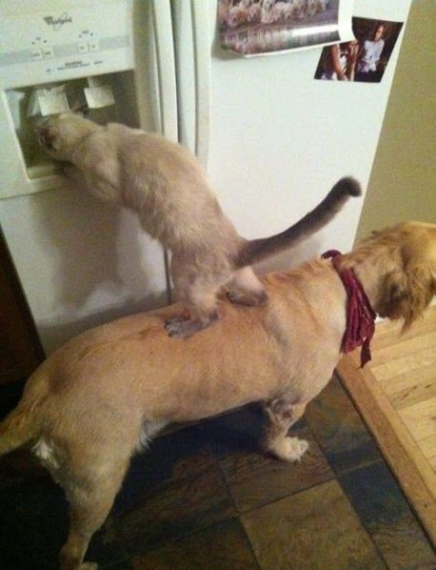
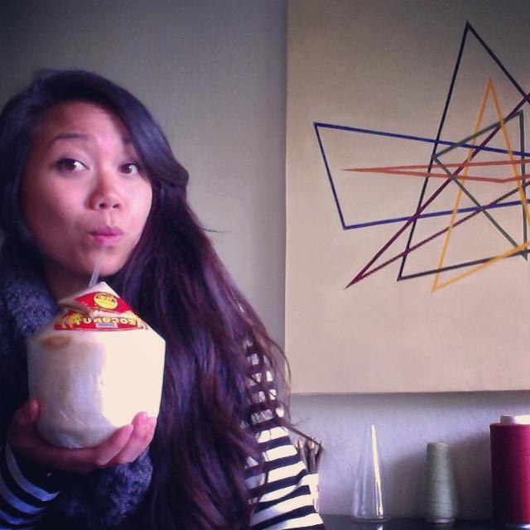

HELLO, My name is
Noki Seekao
Stepping up
& reaching back
Courtney Chung
Dope vector
on beat
Kryshana Ananthan
Wit & Wonder
Notes:
PRESENTER: ALL
Tell a quick personal story that speaks to your tagline

Slide 3
Our Goals
Identify governing values
Clarify purpose
Begin to define a personal brand
Notes:
PRESENTER: COURTNEY

Slide 4
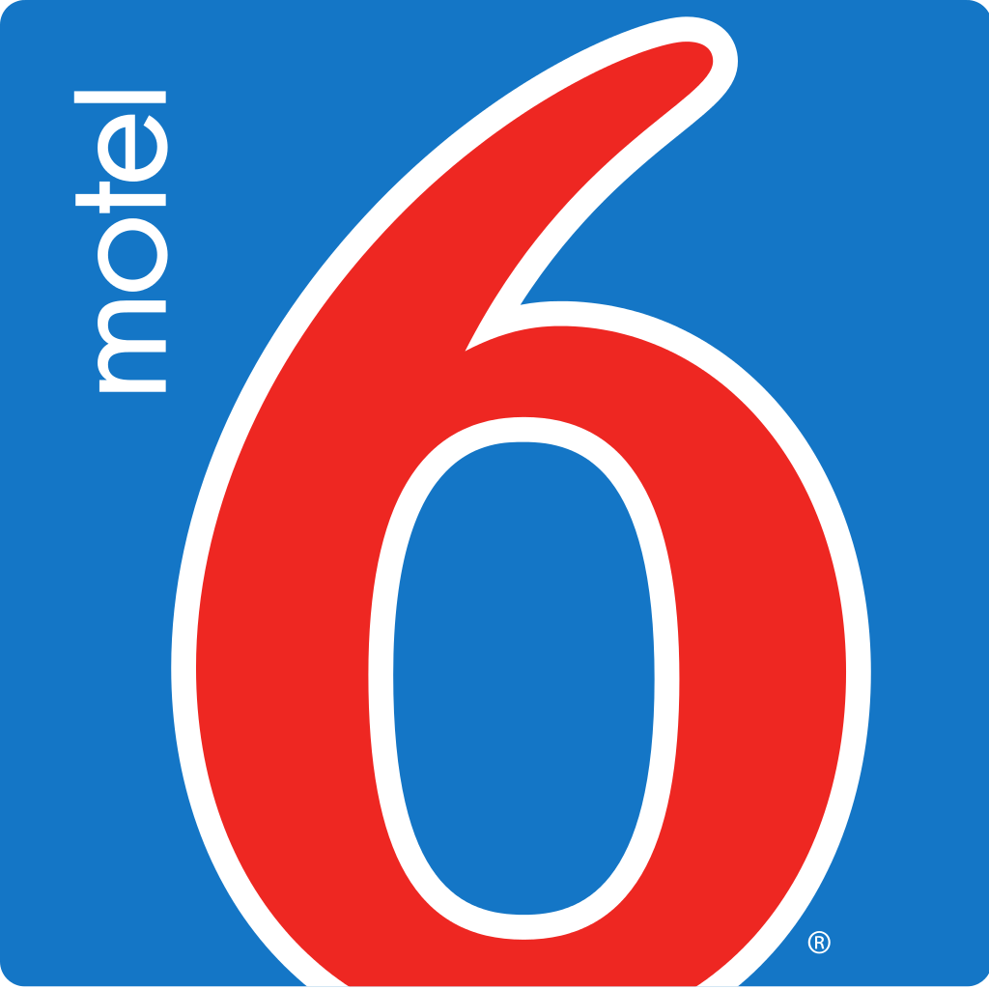





What is a Brand?
Notes:
PRESENTER: KRYSHANA
What are adjectives that come to mind when you see these logos?
on a piece of paper list them out (Perhaps we can ask them to shout them out to keep up the energy.)
These are all companies that our students are more likely to interact with locally.

Slide 5

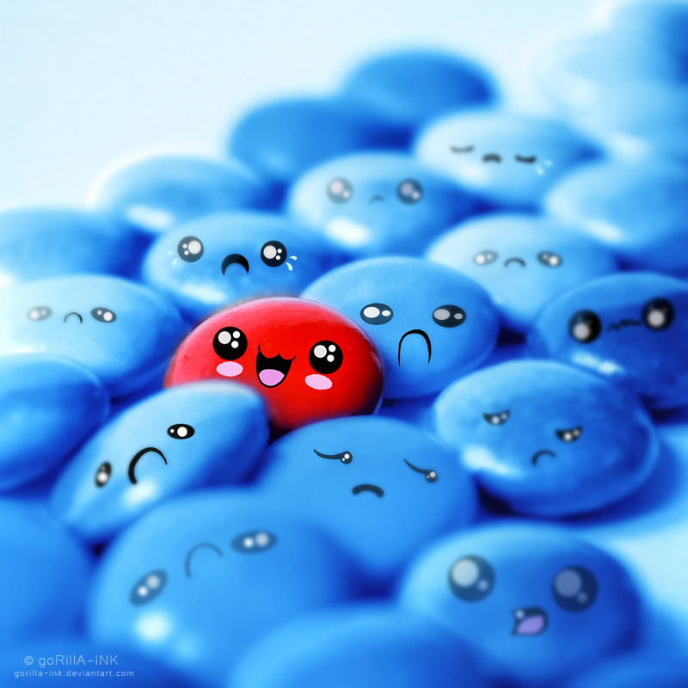
Paul Rand, Idea Book Cover, 1984
Notes:
PRESENTER: KRYSHANA
Your brand is your image seen from the outside
Branding is creating that individual niche in the other’s psyche and owning it
its differentiating yourself as unique
Reference previous slide
We have a preconceived idea of what the companies mean to us and we internalize it as part of our lingo and understanding its place in our world.
Referring to the last slide, what ways have those companies shaped our perception of how we purchase or shop with these companies?

Slide 6
Identifying Values (2 min)
1. What do you do that you enjoy so much that you could do it forever?
Notes:
PRESENTER: NOKI
Before you can get to your brand, it’s important to know where you sit with your guiding values.
Part of recognizing and developing your brand is identifying who you are; what motivates you, guides you, and inspires you.
EXERCISE: Values clarification exercise
We are going to ask you to free write to open ended questions. Do not worry about grammar, just simply begin writing whatever comes to mind. You will be given about 2 minutes to write the first things that come to mind. (Slowly count to 15 after reading each question outloud.)
Give them 2 minutes to work on each question

Slide 7
Identifying Values (2 min)
2. When have you felt your most confident?
Notes:
PRESENTER: NOKI

Slide 8
Identifying Values (2 min)
3. What have others said are your strengths and virtues?
Notes:
PRESENTER: NOKI

Slide 9
Identifying Values (2 min)
4. Who are pivotal people in your life? What are the qualities about them that you admire?
Notes:
PRESENTER:NOKI

Slide 10
Identifying Values (2 min)
5. What would you like to be known for?
Notes:
PRESENTER: NOKI

Slide 11
Identifying Values (1 free min)
What do you do that you enjoy so much that you could do it forever?
When have you felt your most confident?
What have others said are your strengths and virtues?
Who are pivotal people in your life? What are the qualities about them that you admire?
What would you like to be known for?
Notes:
PRESENTER: NOKI
Go back and underline common words that are coming up; group similar values together
These are your governing values (No need to bring in the post-its just yet. The flow was disrupted a bit as folks were confused about the post-its.)
http://charlesstone.com/ask-yourself-these-7-simple-questions-to-clarify-your-personal-values/
https://books.google.com/books?id=wc01AgAAQBAJ&pg=PT49&lpg=PT48&ots=R1u9r3qLfn&focus=viewport&dq=questions+to+ask+yourself+to+clarify+your+values&output=html_text

Slide 12
Key Branding Principles
Be authentic
Be unique
Be consistent
Keep it simple
Tell your story
Reference: http://www.polaris-inc.com/assets/pdfs/9_principles_of_branding.pdf
Notes:
PRESENTER: COURTNEY
We’re only going to highlight key principles
Brand definition becomes your personal mission statement that will help give context and focus to your daily interactions and long-term goals. Your brand definition will change as you change and grow.

Slide 13
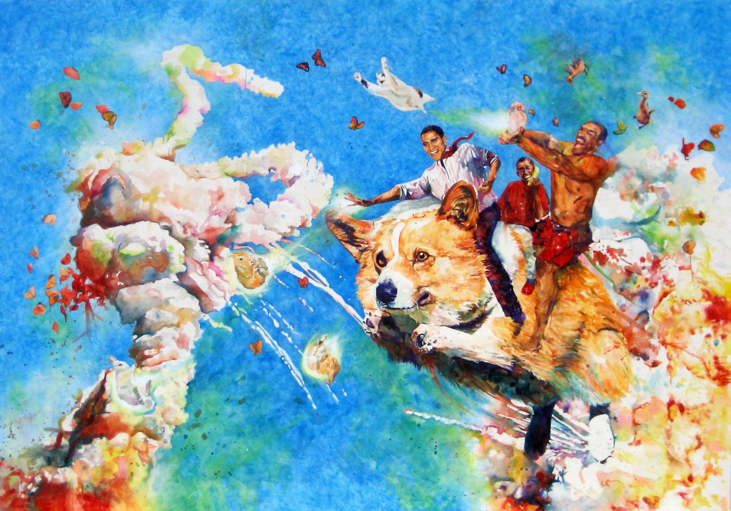

1. Be Authentic
Conrad Ruiz,
Overload, 2009
Notes:
PRESENTER: COURTNEY
EXERCISE (Brag-Storm) | 15 mins
We are now going to do a brag-storm and this is your opportunity to highlight all of your accomplishments both professionally and personally. We're going to do this in two parts, the first is professional accomplishments.
Write down one governing value per _________ colored post-it and place them in a straight line in front of their work space
Think of moments in your educational / professional career that you are most proud of (3 minutes to write 1 “moment” per BLUE post-it)
Moments when you overcame a challenge, received recognition for your contribution or hard work, learned a new skill.
Now think of moments in your personal life that you are most proud of. You will have 3 minutes to write 1 per YELLOW post-it.
Looking at each “moment”, place the post-it under the value that you think was most exemplified or expressed in that moment. (Place them under one of the guiding values on the RED post-its that you feel influenced you in that accomplishment.)

Slide 14

2. Be Unique
Paul Klee,
The Goldfish,
1925
Notes:
PRESENTER: COURTNEY
EXERCISE (Brag-Storm, continued)
Now that we’ve mapped out on post-it’s who we are, values and moments of accomplishment that shape us, let’s take a closer look at which of these values and moments speak to our uniqueness as an individual.
Looking at your values, place a star on the 3 that you feel stand out the most. These 3 values are likely the values that have the most “moments” listed underneath them.
Now looking at the “moments”, star at least 3 in each value category that you are most proud of and/or most differentiate you from others.
EXERCISE (Introduction)
Hopefully, we’ve narrowed down your values and experiences to those that are most representative of who you are, your authentic self, and your individual experience, your uniqueness. How would you express your authentic self and uniqueness to someone just meeting you for the first time?
Write 3 bullet points that you would use to describe yourself to a new friend, someone who does not know anything about you but has the potential to be a part of your life. (try question differently per session) | 3 minutes
Would anyone like to introduce themselves to the group by reading their 3 bullet points?
That was a great practice run in verbalizing who you are in a succinct and clear way. The next step in developing a personal brand is to develop consistency.

Slide 15
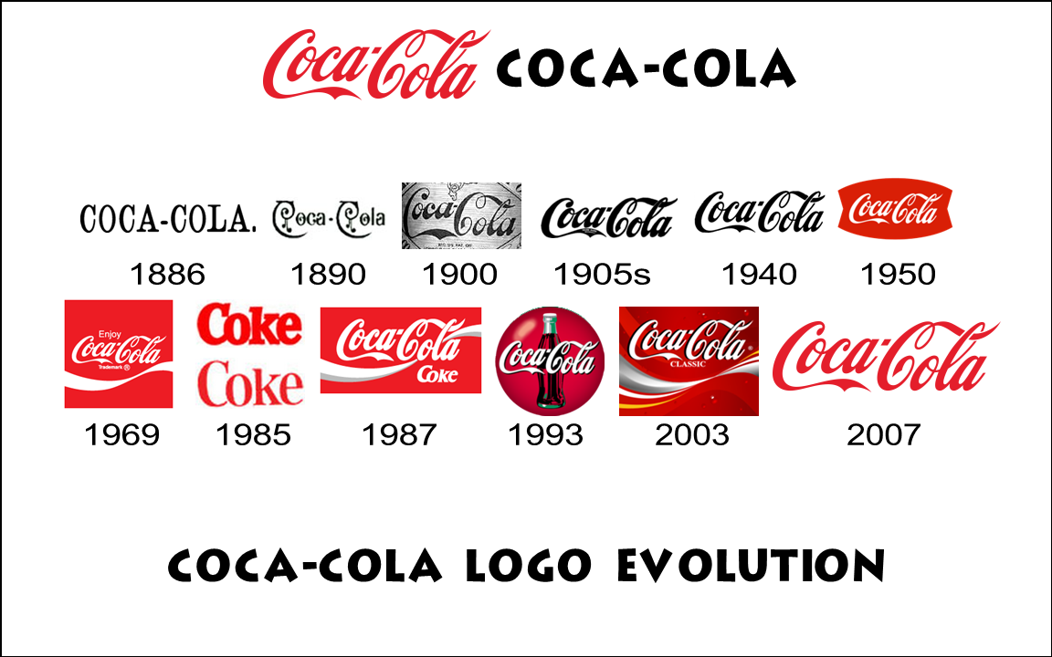
3. Be Consistent
Notes:
PRESENTER: COURTNEY
Reflection on Exercise (Brag-Storm)
Look for similarities and/or differences between professional and personal (values and/or achievements)
Questions to ask yourself: Is there a discrepancy? Do you prefer it that way? Why? How does it serve you? How does it not?
Things to consider: People are happier when their professions are in line with their values
Coca-Cola brand evolution
QUESTIONS
What is the first thing that comes to mind?
What is consistent across the logo?
Brand consistency
Variations will happen as you grow and evolve
Your core values (on the _______ colored post-its) serve as the foundation of your brand or in this case Coca-Cola’s name in italic
http://www.indiana.edu/~jlpweb/papers/Values%20Management_Paarlberg_Perry_ARPA_2007.pdf
Within an organization, a strong value system is said to exist when organization members share key values related to acceptable behavior within the organization and the organization’s strategic direction (Weiner, 1988) and, more important, that they share the espoused values of organizational leaders (Deal & Kennedy, 1982).

Slide 16
4. Keep it Simple
Just do it.
I’m loving it.
Eat fresh.
The happiest place on earth.
The ultimate driving machine.
It gives you wings.
Notes:
PRESENTER: Courtney
EXERCISE: ask students to identify the taglines for these companies. Answers are 1) Nike, 2) M&M, 3) McDonalds, 4) Subway, 5) Disneyland
To separate your message from the noise is to be focused, personal, and simple.
Your consumer must choose to pay attention.
There is a time and place for detail...but only after they are interested!
Any other taglines come to mind?
It takes courage and skill to present a simple message ---- “to build a world-class organization or product requires attention to every detail. when it comes time for marketing my job is to say, “ i realize that most of these little things are really cool, but only one big thing is going to get people’s attention.”
“if you want people to listen, you have to find a way to keep the message simple.”

Slide 17

5. Tell Your Story
Keith Haring,
Best Buddies, 1990
Notes:
PRESENTER: KRYSHANA
A brand definition, works for a company on a regular basis. it defines not just what they do, but who they are and who they want to present themselves as.
so define your brand, write it down and enforce it.
brand qualities should describe a person, company, product, service the way you might describe your child to a friend.
EXERCISE
this is a visual exercise for folks
place ads and everyone has an opportunity to pick one image that stands out for them
place them in pairs
everyone gets 2 minutes to share why they picked their photo;

Slide 18
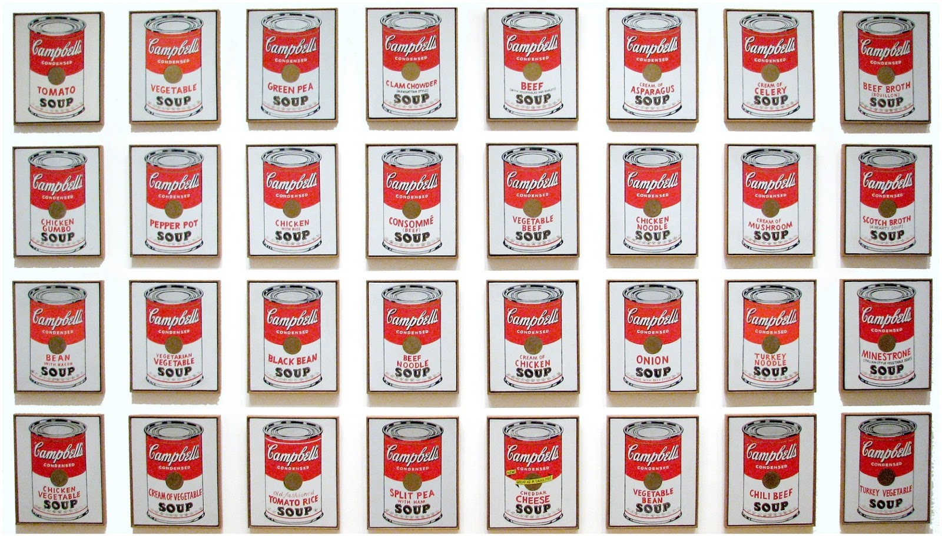
What is Your Personal Brand?
Andy Warhol,
Campbell’s Soup Cans, 1962
Notes:
PRESENTER: KRYSHANA
EXERCISE
folks will give a pechakucha and give their brand statement
audience will give one word response for audience [mimics critique process]
A written brand definition is that you know have a set of criteria to base decisions on
Brand definition becomes your personal mission statement that will help give context and focus to your daily interactions and long-term goals. Your brand definition will change as you change and grow.
Handout
Different resources on branding
How to leverage based on current social media trends
Link to presentation
Wrap Up
Now that you’ve presented your brand to those who may or may not know you very well, take your taglines to people who may know you better in your professional, educational, and personal communities.
ONE point from each presenter to close the loop
Kryshana - Wordsmithing, testing to see if your tagline is accurate to the brand that you want to express
Courtney - Authenticity, testing to see if your tagline expresses your true and unique self
Noki - Values, testing to see if your tagline is aligned with your core values
- Ask questions of why it is important for them to define their own brand, what does it mean for their identity group, how does this help shape others' perceptions? [questions to be fleshed out]

Slide 19
Tips
Avoid fads
Avoid buzzwords
Be authentic
Be unique
Remember your star values and moments!

Slide 20
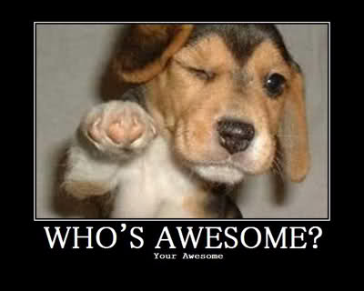
Thank You!
Noki Seekao
California College of the Arts
Director of Student Life
noki@cca.edu
Courtney Chung
California College of the Arts
Assistant Director of Academic Advising
cchung@cca.edu
Kryshana Ananthan
Duarte, Inc.
Designer
k@kryshanaananthan.com

